Slide 2
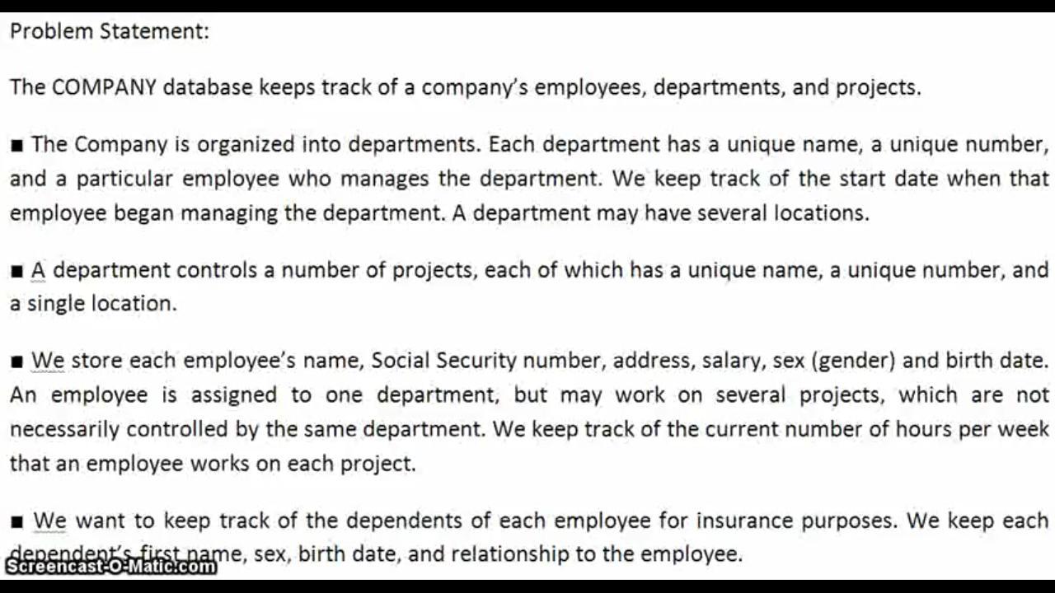

Slide 3
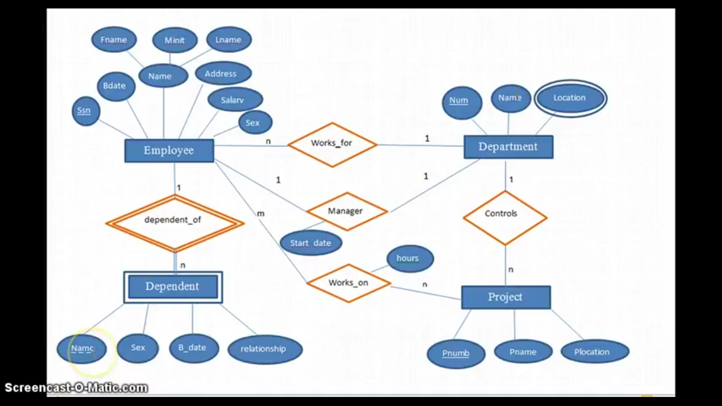

Slide 4
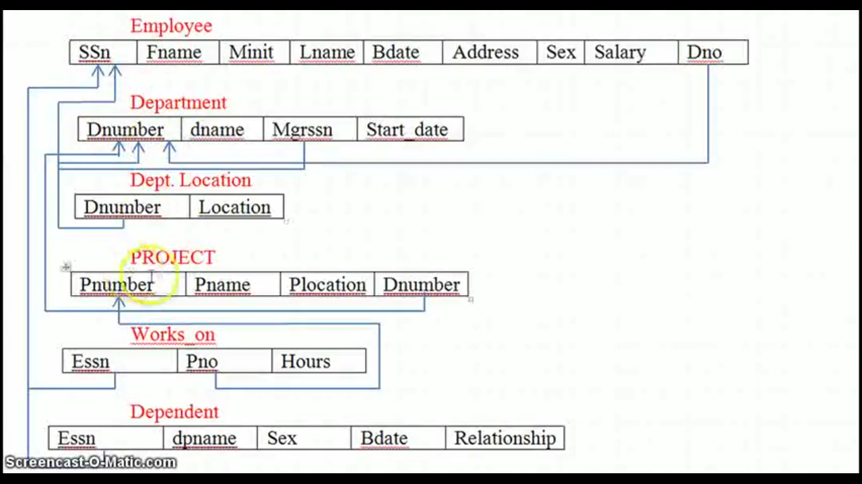

Slide 5
2) Construct an E-R diagram for a hospital with a set of patients and a set of medical doctors and Specializations in hospital . Associate with each patient a log of the various tests and examinations conducted

Slide 6
1)A faculty has following entities:
(a) courses, including code, title, credit hour
(b) students, including student-id, name,phone,address,email
(c) Doctors , including identification docid, name, department, and title,address,phone,email .
(d) departments including code ,department name,details
Construct an E-R diagram for the registrars office.Document all assumptions

Slide 7
